Slide 1

Artisanal Sector in Impact Investing: A blind spot and unexplored potential (Workshop at SOCAP 24 on 30th October, 2024 at Yerba Buena Center for Arts in San Francisco, USA)
Presentation by Stephen Rwagweri, Founder African Continental Crafts

Slide 2
Deficiency adjectives associated with Artisan Sector?
Unexplored – undiscovered – underrepresented – unnoticed.

Slide 3

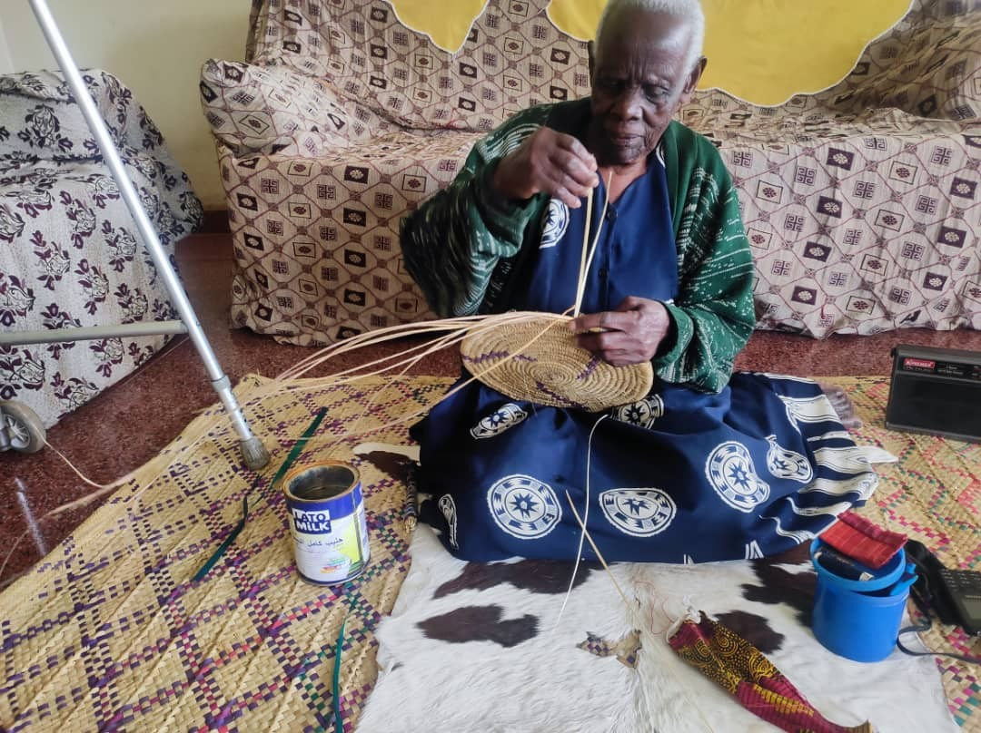

Slide 4
What?
Impact Potentials – new insights – new perspectives – new possibilities – new opportunities

Slide 5
To achieve what?
Universal economic inclusion– equalization of productivity– reclaiming productivity– reclaiming social relevancy– providing therapy.

Slide 6
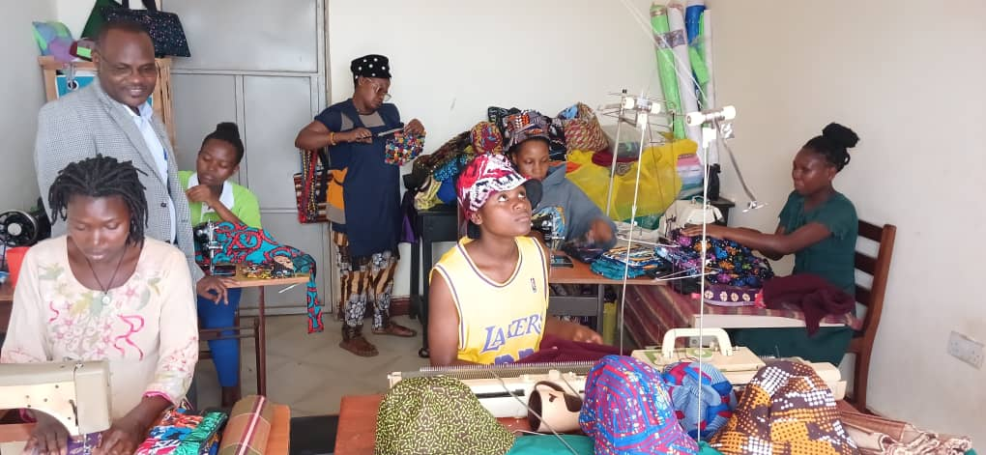
Case study: G.W Akora of YAWE Uganda uses crafting to provide social, spiritual, economic and physical recapitulation to PLHIV but must adopt international hawking in search for sympathy buyers around the world for products that are potentially market competitive if innovation, policy and impact investment were enabling

Slide 7
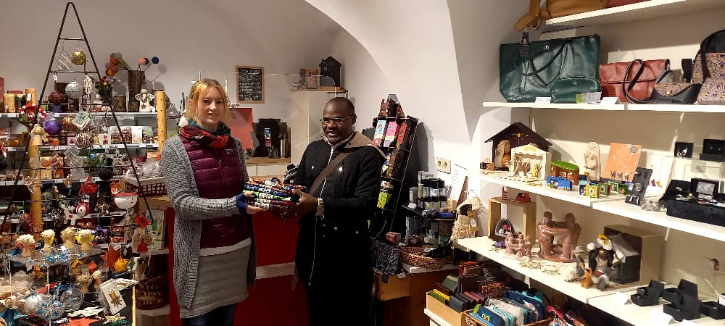

Slide 8

What are these unexplored potentials?
Universality– maximum adaptability to limitations – maximum adaptability to resource deprivation– first and basic livelihood skills– fallback position when physical and technical vibrancy fails – driving gender balance – intersection of critical impact sectors – spring board of grassroots-based innovations – Nature and human friendliness – commercial viability.

Slide 9

Undesired sector conditions.
Predominantly crafted in:
Only country specific programming – stand alone, micro and often sporadic transnational initiatives.
Predominantly served with:
Pettiest attitude– tokenism– charity and sympathy– handout - based funding models – marginalization in policy making.

Slide 10

Desired Sector Conditions
1. Transnational comprehensive models.
Examples:
Made 51 by UNHCR
6C Framework by Creative Million
Traditional Artisan Inclusion by African Continental Crafts
2. Sustainable and comprehensive impact funding.
Philanthropy and grants for capacity development.
Social loans and equity for digital marketing and trade.

Slide 11

Annual global sector worth
Estimated US$ 1 trillion (2024) with 20% annual gross rate. (PBP: 2020)

Slide 12

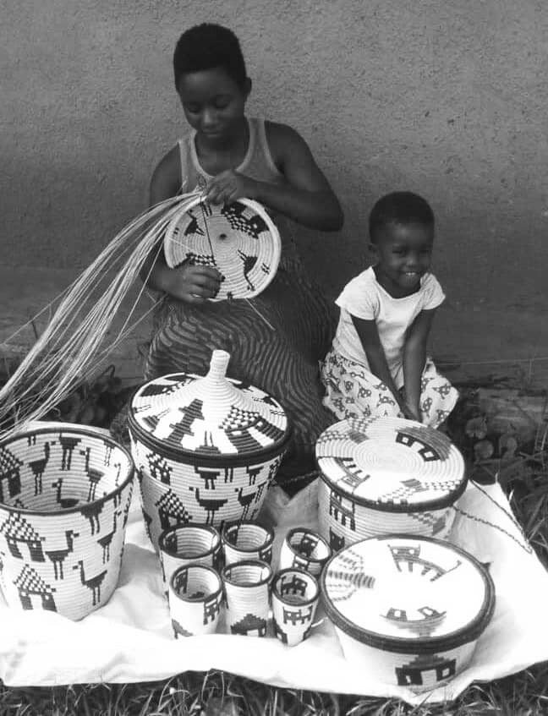

Slide 13
Contact details
Plot 18, kaija Road
Fort Portal Tourism City - Uganda
+256 (0) 772469751
Emails: africancontinentalcraftsltd@gmail.com/info@africancontinentalcrafts.comFacebook: https://www.facebook.com/African-Continental-Crafts-108224698386319
Twitter: https://twitter.com/AfricanContine5
Website: https://africancontinentalcrafts.com/

Slide 14
Thank you

